Slide 1
La Madeleine – Location & Review Insights

Slide 2
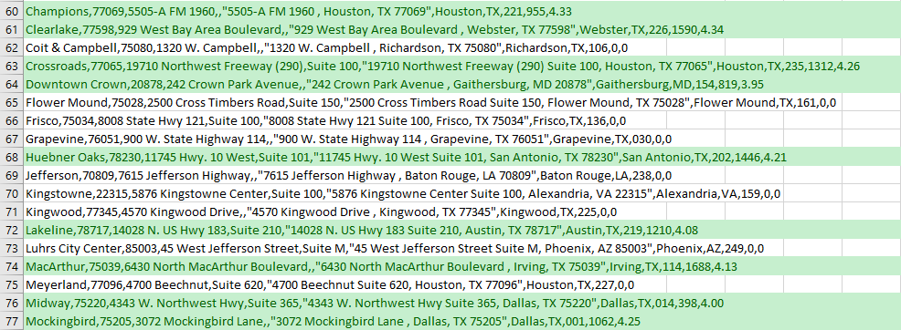
Coverage
Total Locations: 86
Locations with Reviews: 21
Review Coverage: 24%
Google Reviews dataset covers only a couple of locations.

Slide 3
XPaths
locationName //div[contains(@class,'location__name')]
Hours //p[contains(@class,'location__hours')]
Distance //div[contains(@class,'location__distance')]
phoneNumber //div[contains(@class,'location__phone')]//a
Latitude+longtitude = destination=([-0-9.]+),([-0-9.]+)

